Slide 1

Mr robot CTF VM
baconandeggs

Slide 2
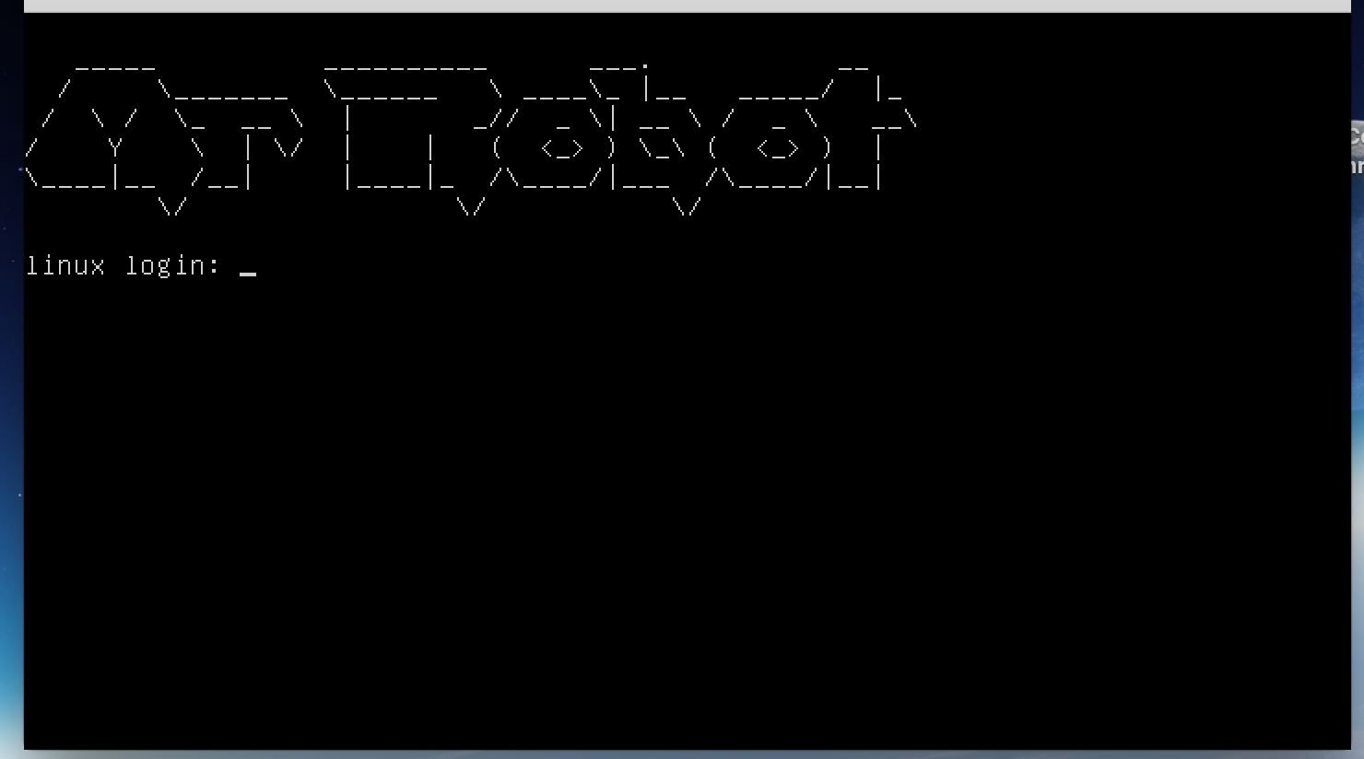
The VM
Tried logging in with some bullshit username and password like a sped :/ - note to self.. Doesn’t work!
So how I do things with this thing?

Slide 3
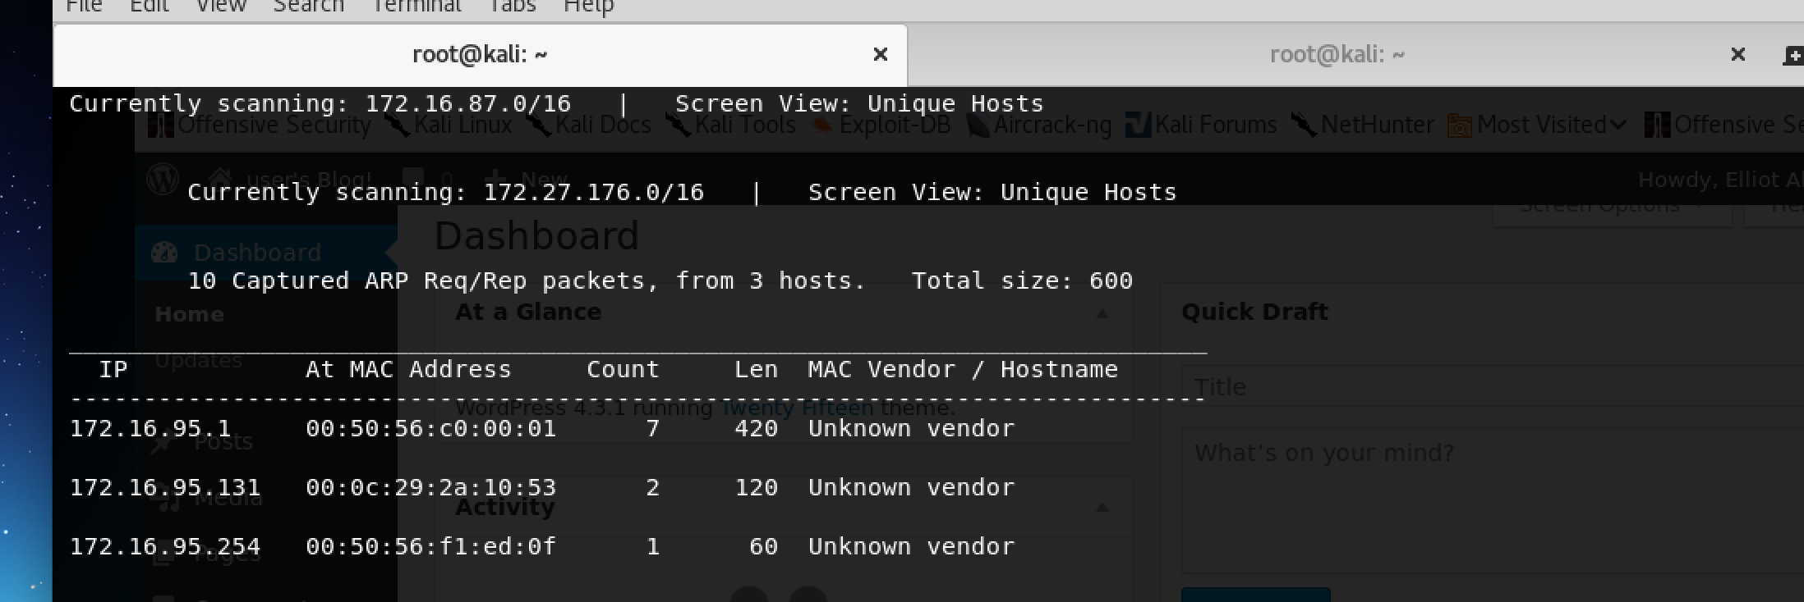
Kali
So I needed to get some sort of address to jump on?
Googled some shit and found netdiscover - which scans for network address
Couldn’t c0nnect to any of these ip address’ when I punched them into my browser
C_sto to the rescue… both kali and mrrobot have to be host-only

Slide 4
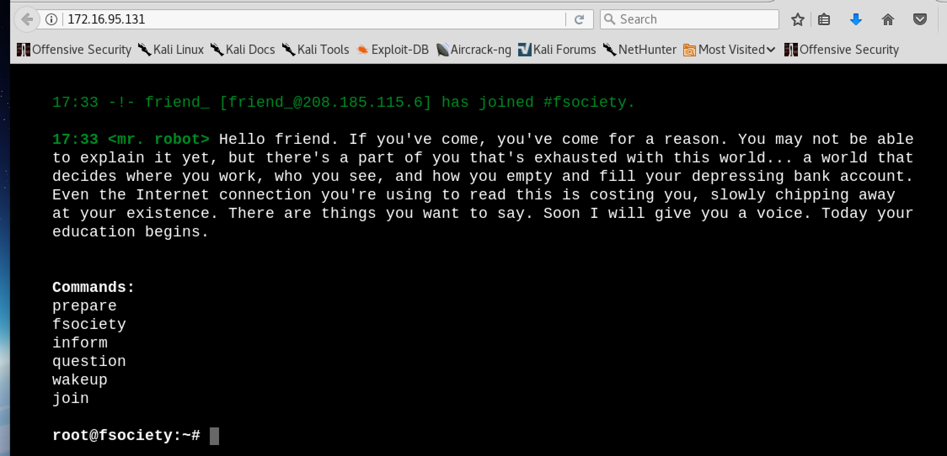
I got it working I think?
So this “terminal” popped up on my web browser
I typed in all of the commands expecting one of them to give me the username and password for the shell in the mrrobot vm? WRONG
All I got was some cool mrrobot shiz

Slide 5
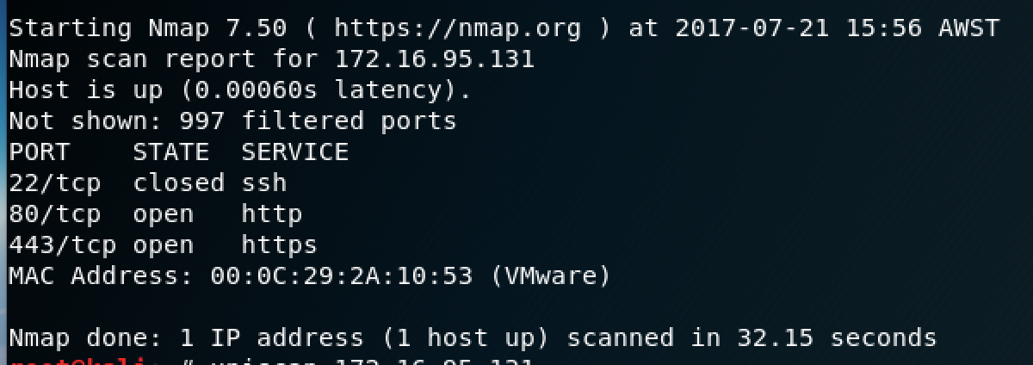
Nmap?
So I nmap’d the working ip address and found that ports 80 and 443 were OPEN! Yay? Cool but why is this so important? Plz help/explain more?

Slide 6
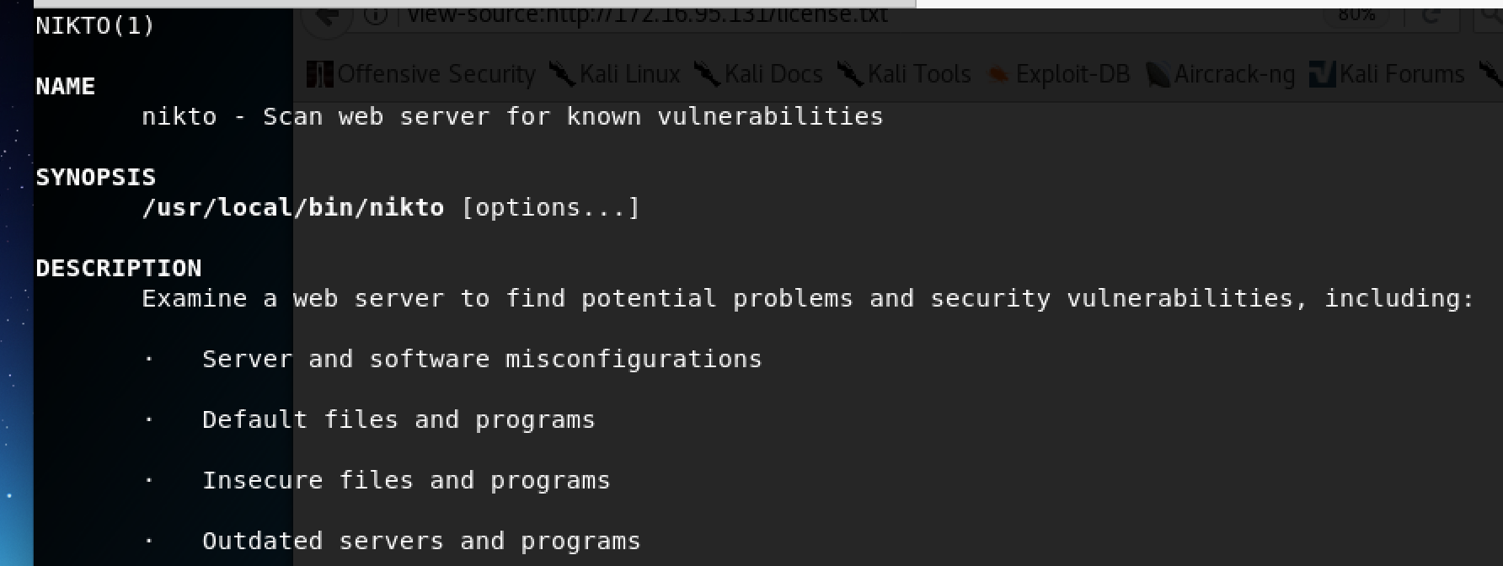
How do I actually find vulns?
NIKTO
So nikto scans for vulnerabilities to exploit

Slide 7
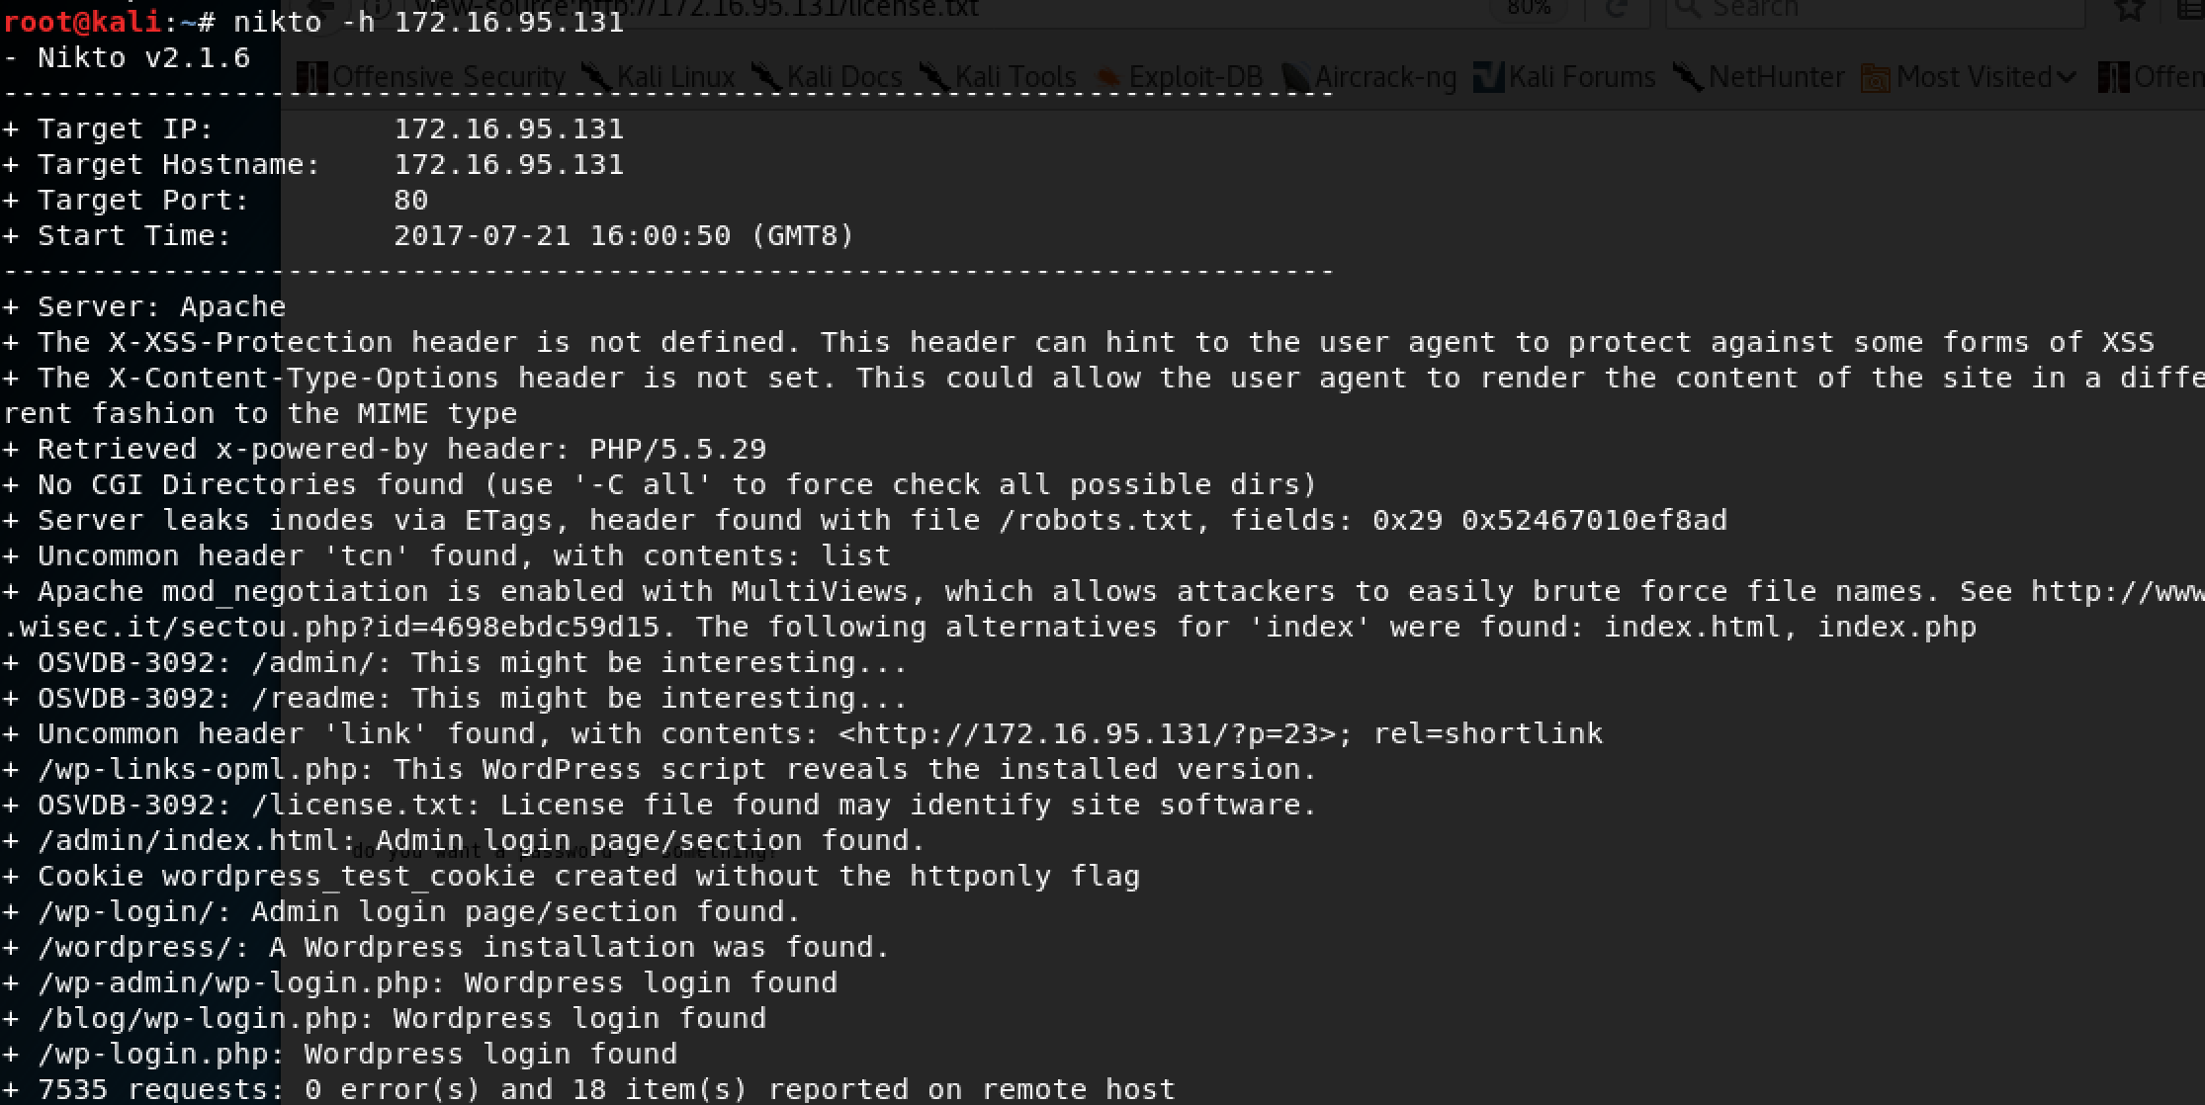
Nikto results
So nikto –h <ip address I typed into my browser>
Popped up all the things I could exploit
Lets just go top-down right?
/robots.txt – ive heard of this b4?

Slide 8
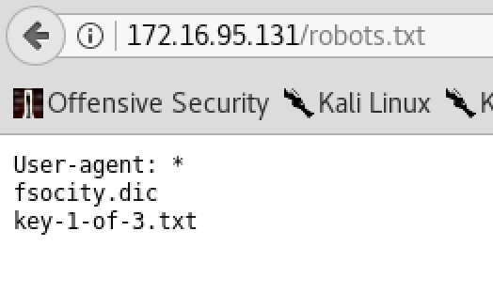
Web robots
Web site owners use the /robots.txt file to give instructions about their site to web robots
So this gives us two other locations/files
/fsocity.dic & /key-1-of-3.txt

Slide 9
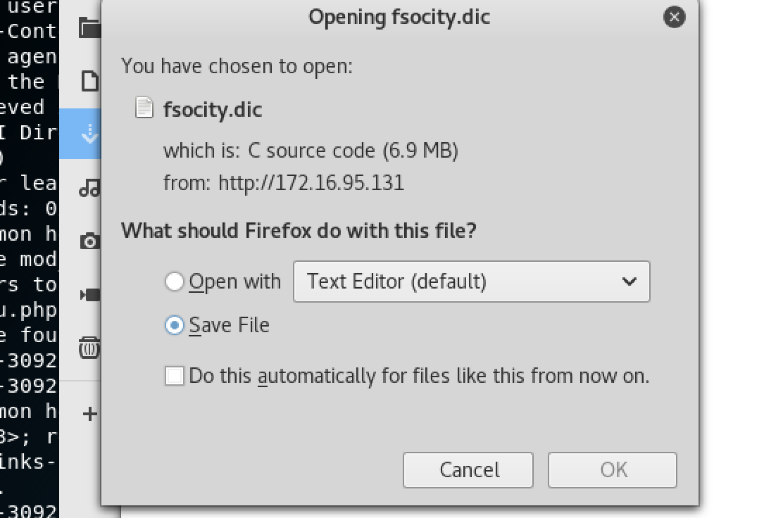
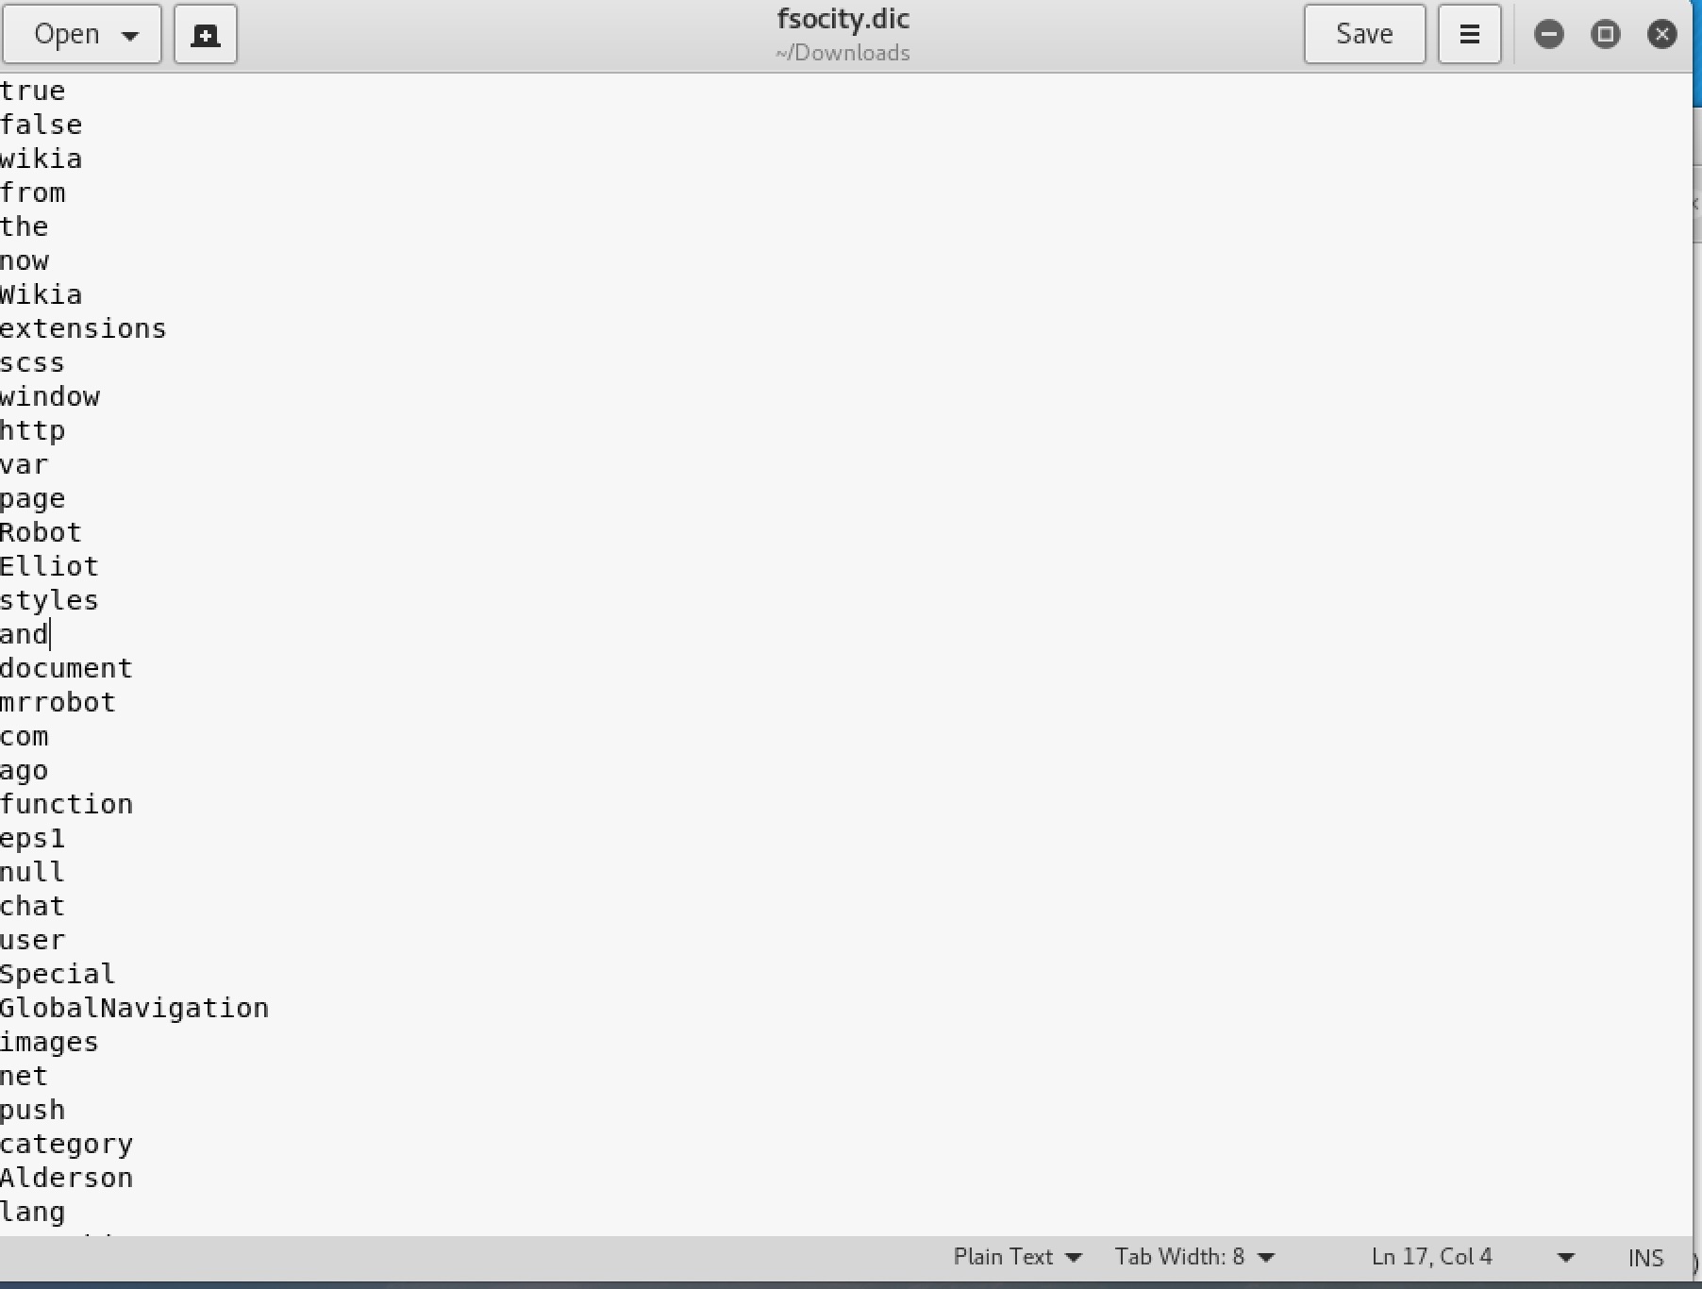
Fsocity.dic
C source code
Basically a list of words?
A bruteforce dictionary?
Hit a dead end with this

Slide 10
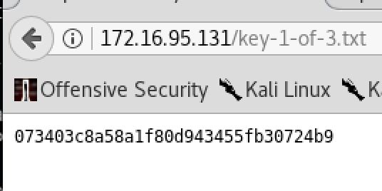
key-1-of-3.txt
So this /key-1-of-3.txt
This key looks like some hexadecimal number or something?
Nothing when I cyberchef’d it?
Lets save this then? 073403c8a58a1f80d943455fb30724b9
Key 1 of 3? So two more duh? So I didn’t know what else to do with robot.txt stuff so I moved onto to the next thing in the nikto list

Slide 11
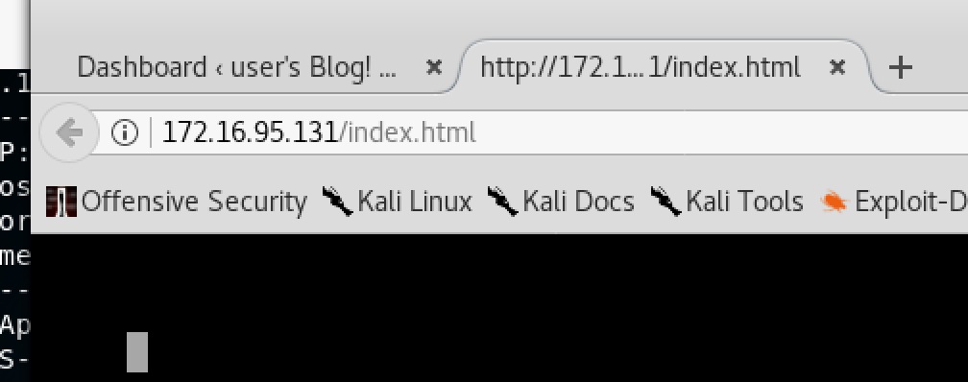
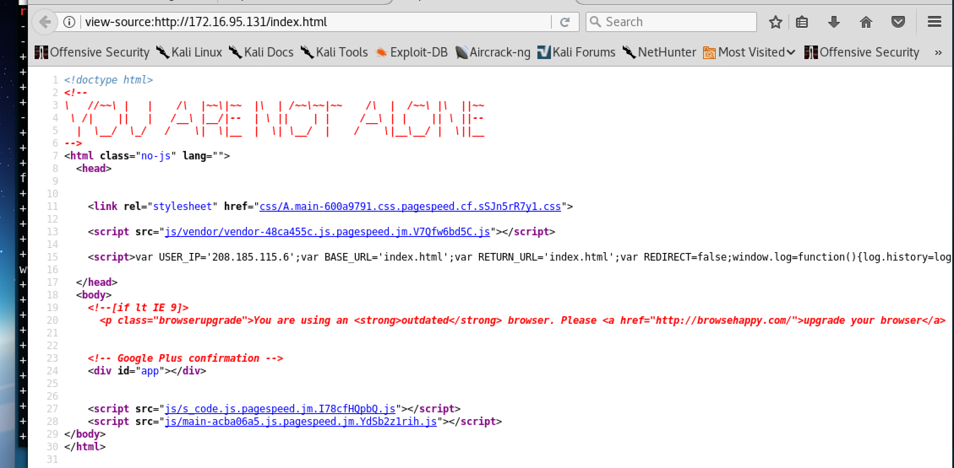
Index.html && index.php
/index.html and /index.php ? Didn’t result in much apart from some cool ascii? So moving on to the next thing..
Im spazzing out. gif

Slide 12
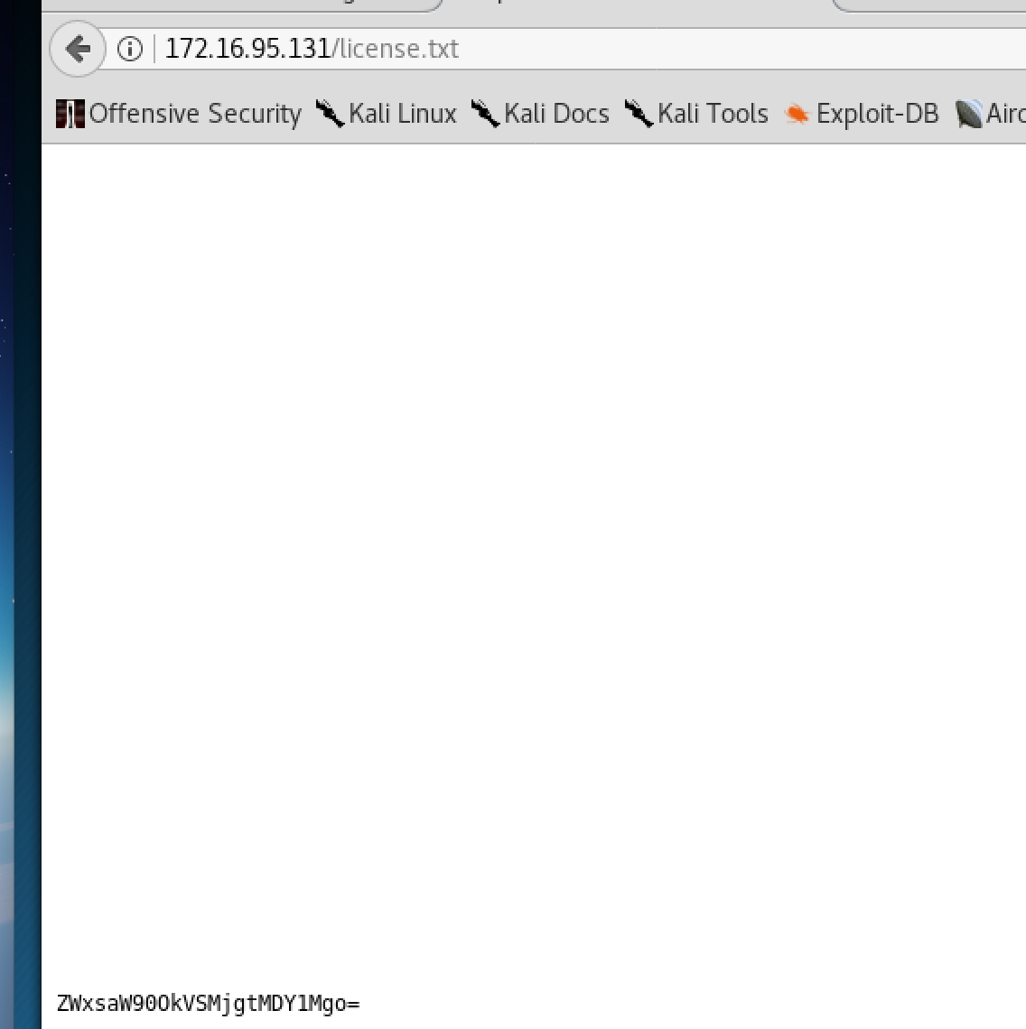
/licence.txt
ZWxsaW90OkVSMjgtMDY1Mgo=
Base64 – the = sign is the giveaway?
So we should convert this base64 to some human readable stuff ?

Slide 13
Base64 decode in bash?
Normally id just convert the base64 to plaintext using cyberchef
Thought id go the bash route and do the conversion in the terminal .. Looking at you here mr duncan!
So is this the login to this?
NO, try harder ☹

Slide 14
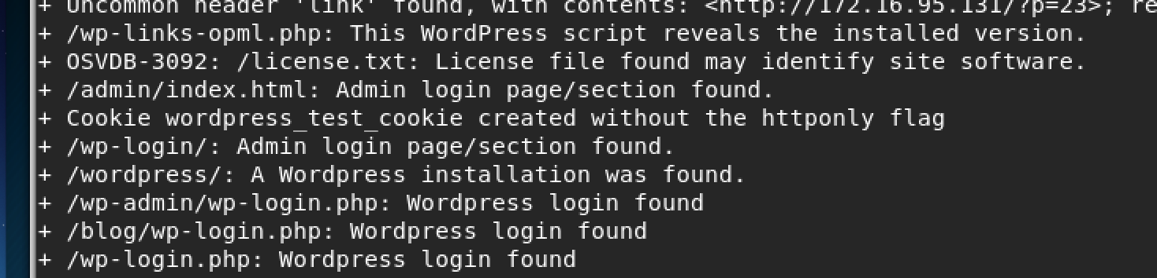
Trying Harder
So in the nikto output .. Theres a whole bunch of wordpress login stuffs .. So maybe the login credentials could be used in one of these wordpress pages?

Slide 15
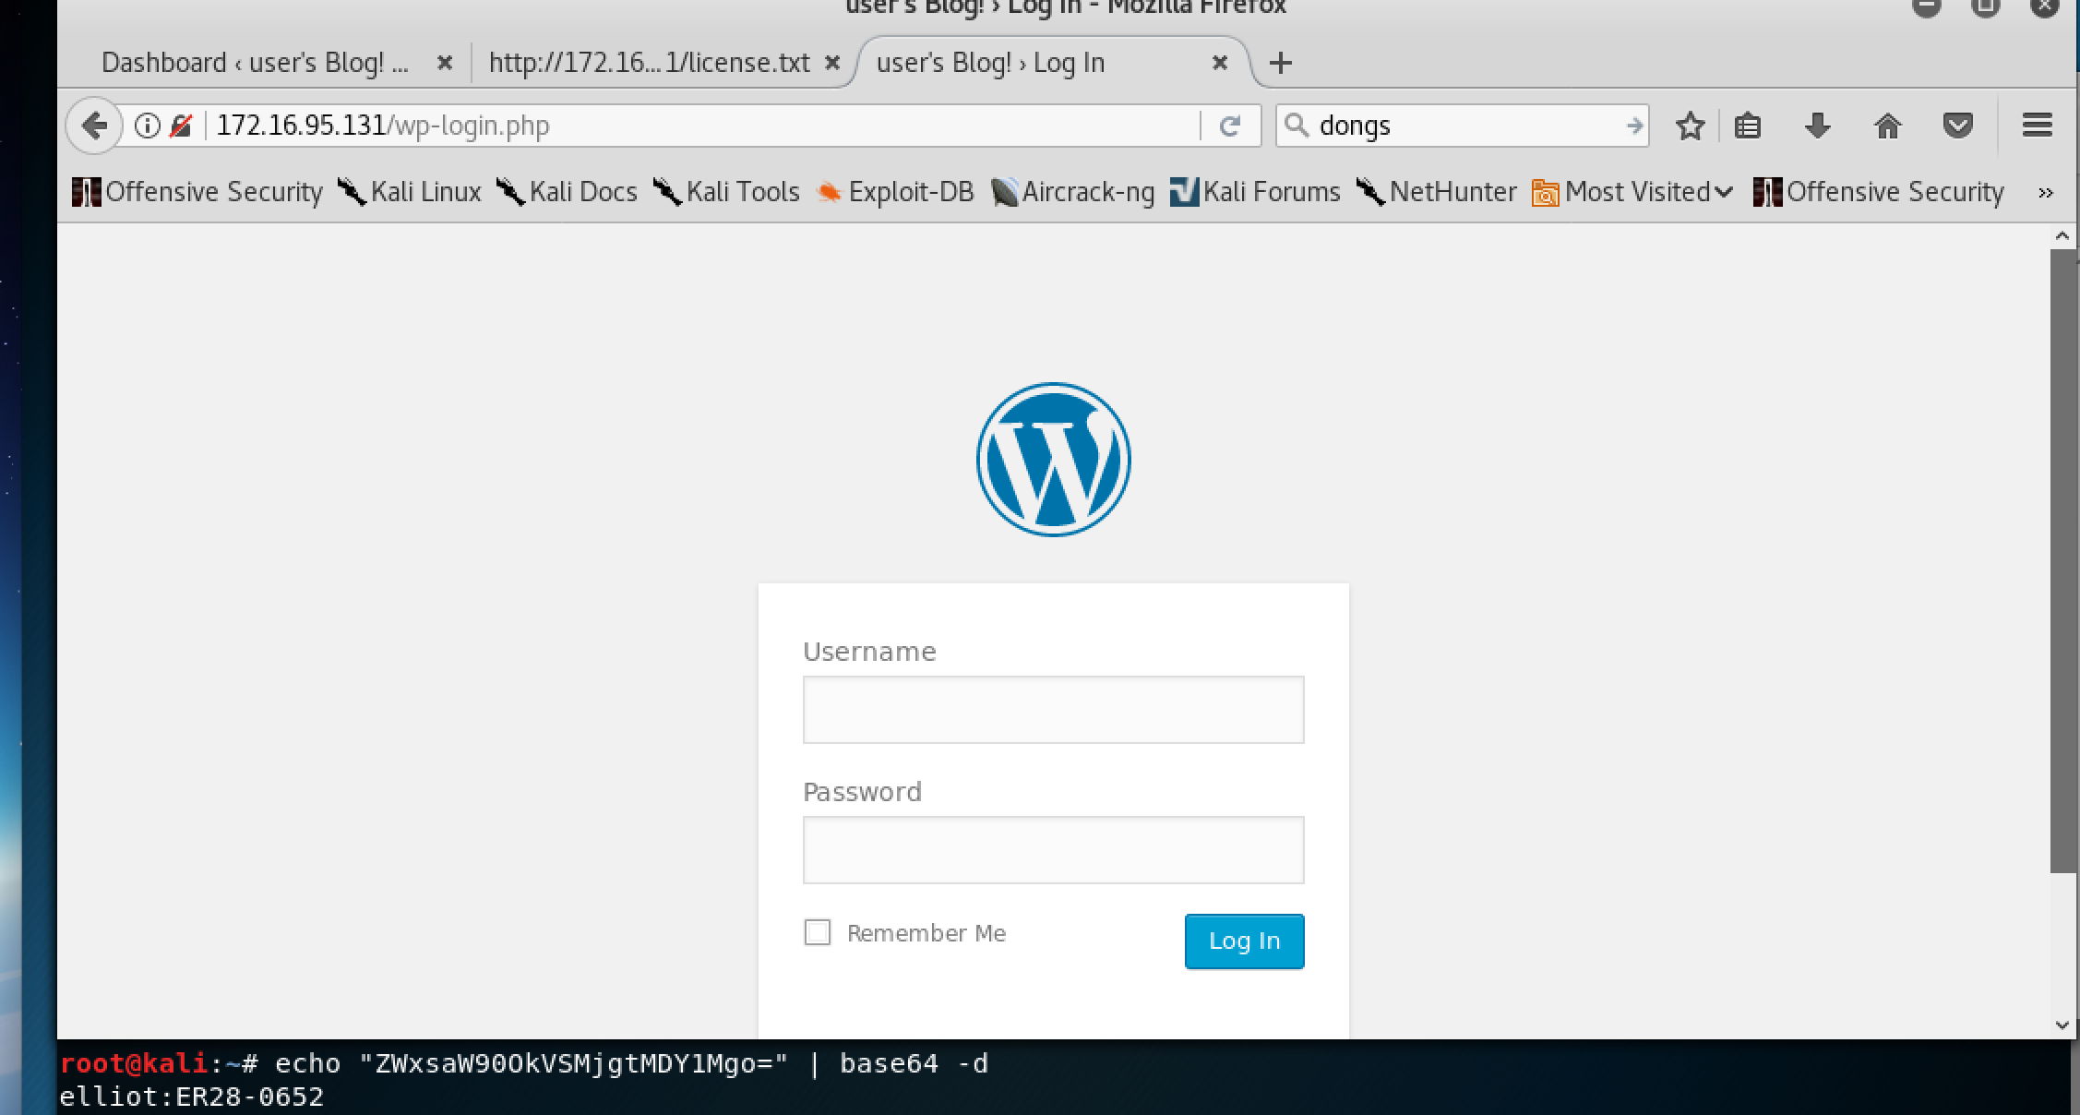
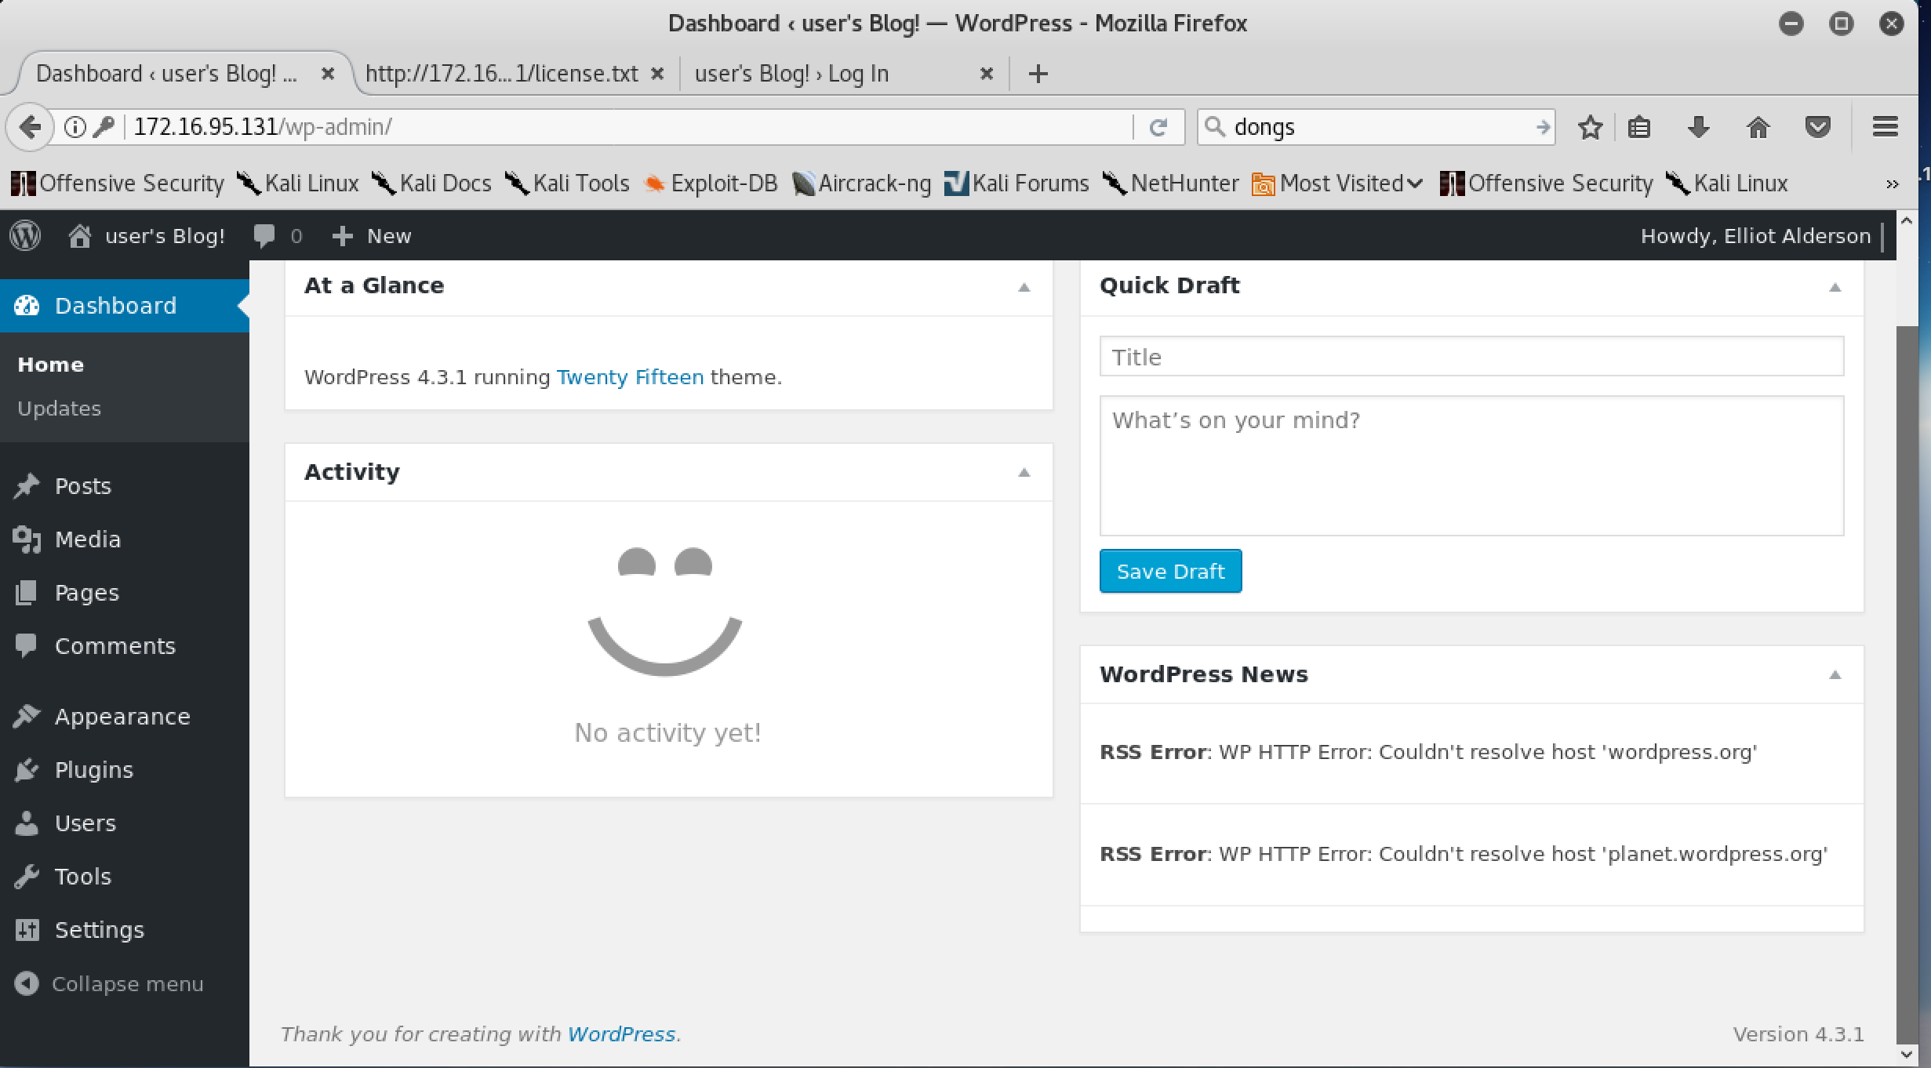
Howdy elliot alderson!

Slide 16
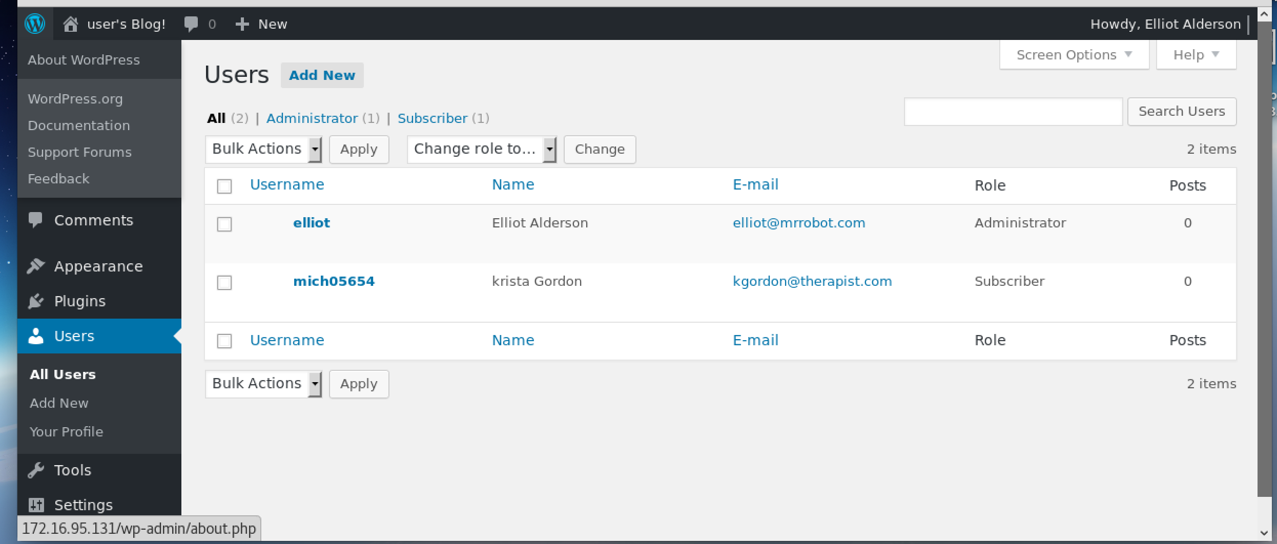

Slide 17
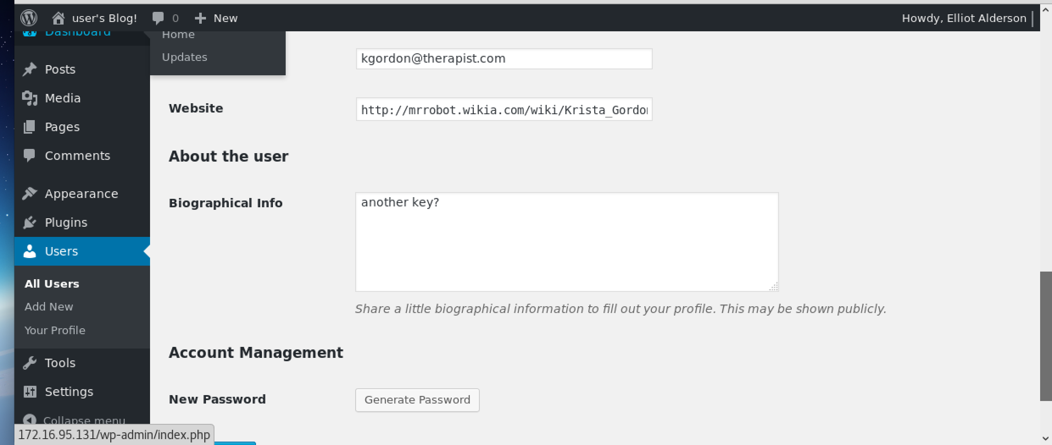

Slide 18
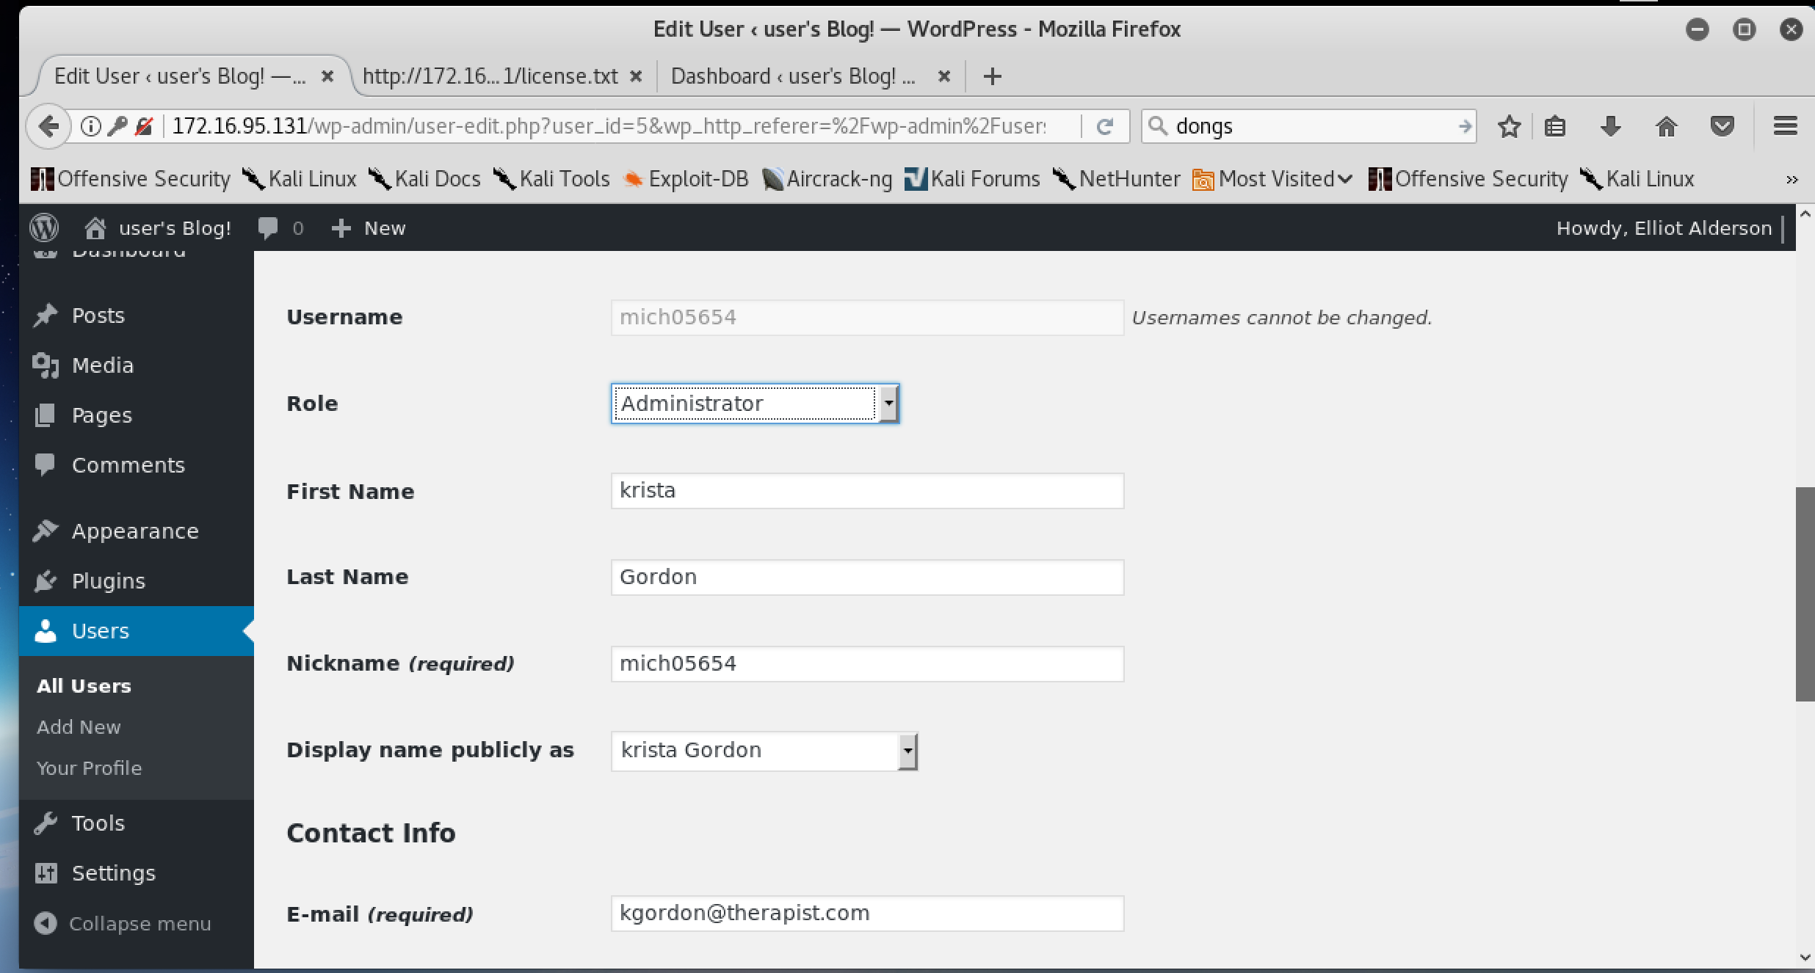
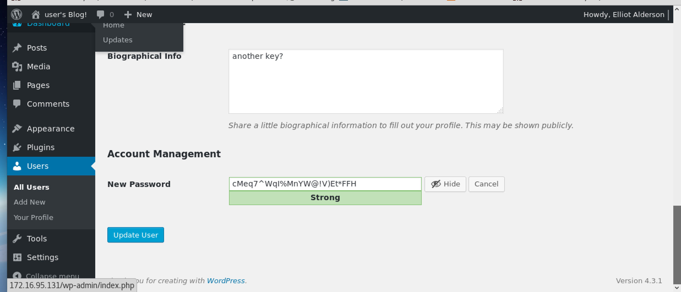

Slide 19
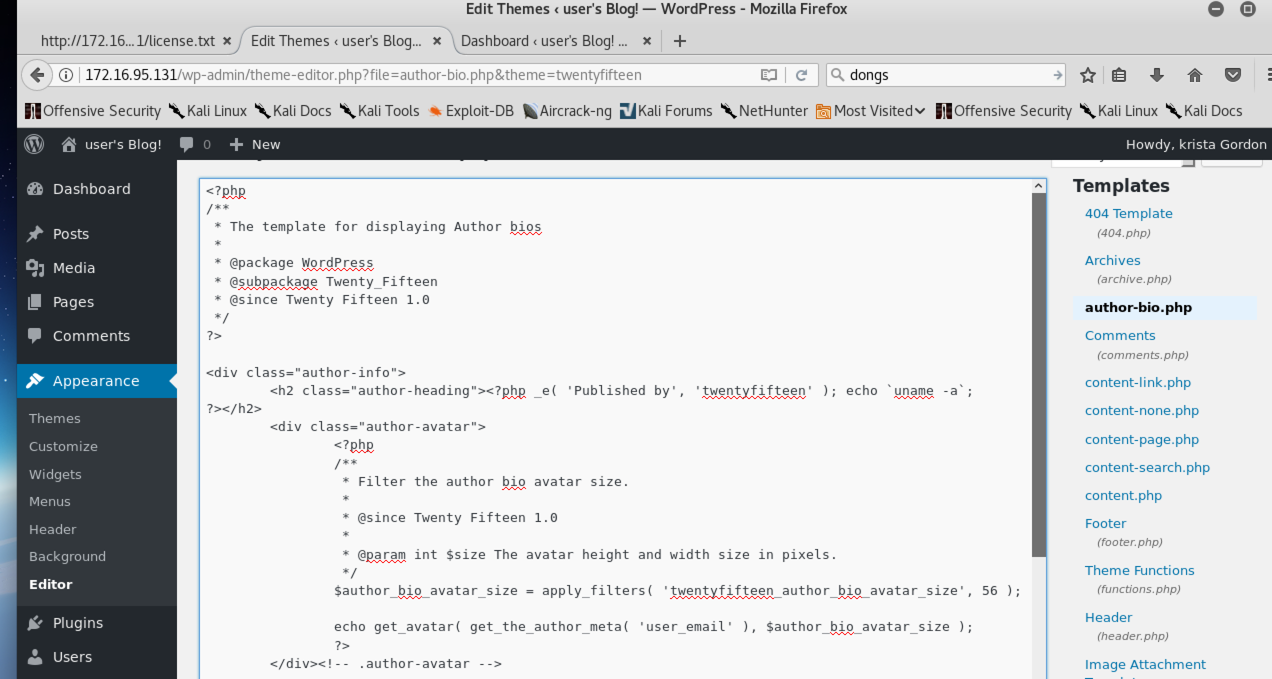
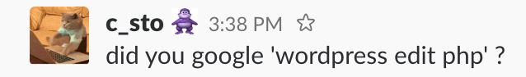
Krista gordons account
So its an admin account now
What next? Somehow get shell from wordpress admin apparently…
After spending way too long looking for the wrong thing on google
Edit this php page? And go on it I guess? No wtf are doing? Srsly?

Slide 20
After googling for sometime..
so I went onto the /author-bio.php page.. And in the source this was the first line?
Finally the system host info? Whats so special about this right? Dunno, go find out!
Turns out it’s the system info for the VM..
And that I can get shell from a admin wordpress account? PHP?
Server-sided scripting language?

Slide 21
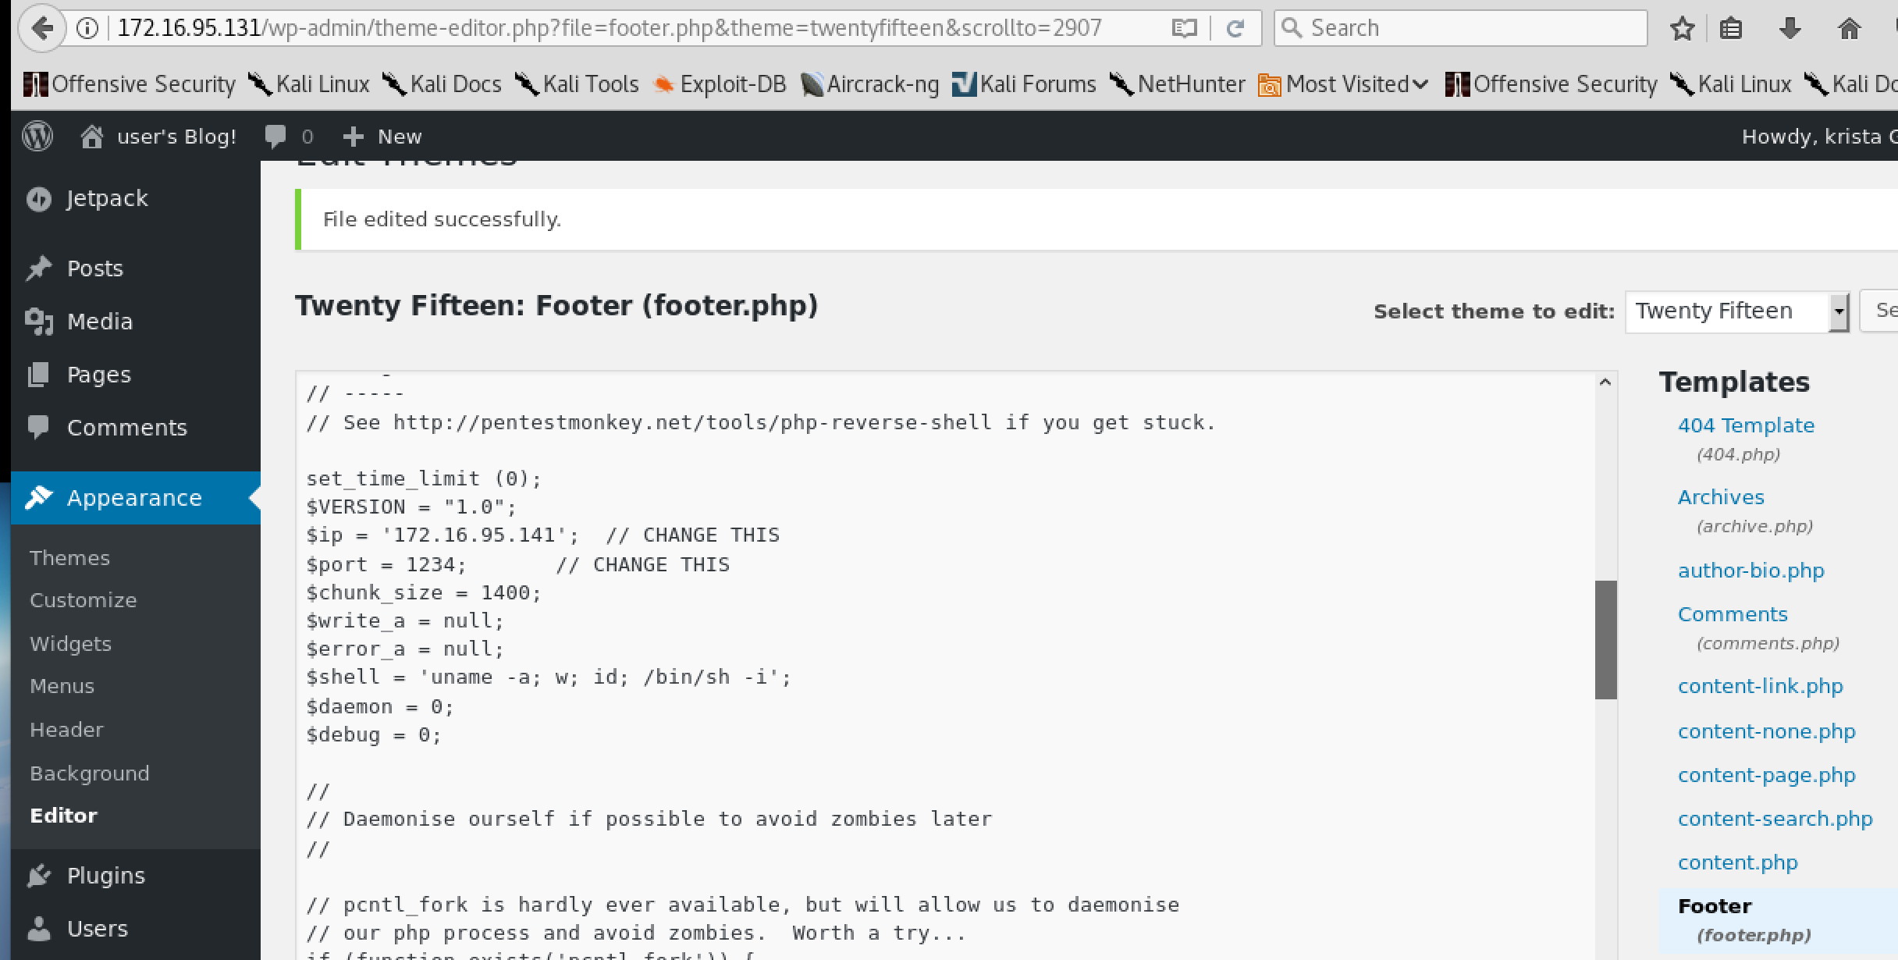
Reverse-php-shell
Pentestmonkey
Reverse-php-shell script
Didn’t work for the first 25 times? I don’t really know why..?
I put this into the footer.php as advised

Slide 22
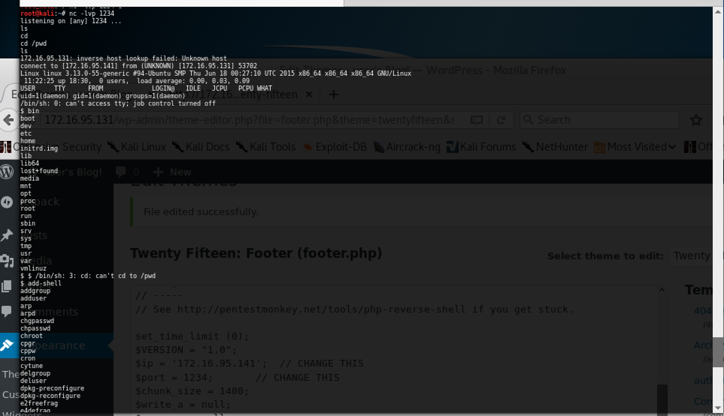
Nc –lvp <1234?rANDOMPORT>
So I punched in my kali VM’s ip address into the pentest monkey script and a random port to listen out for!
So on kali – nc –lvp <port I chucked into the pentestmonkey script(1234)>
And boooom finally popped a shell!

Slide 23
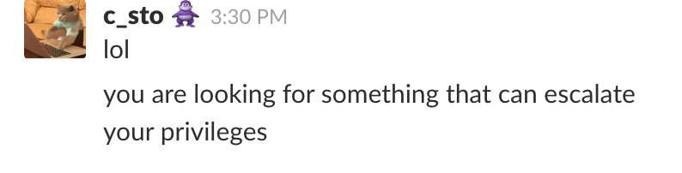
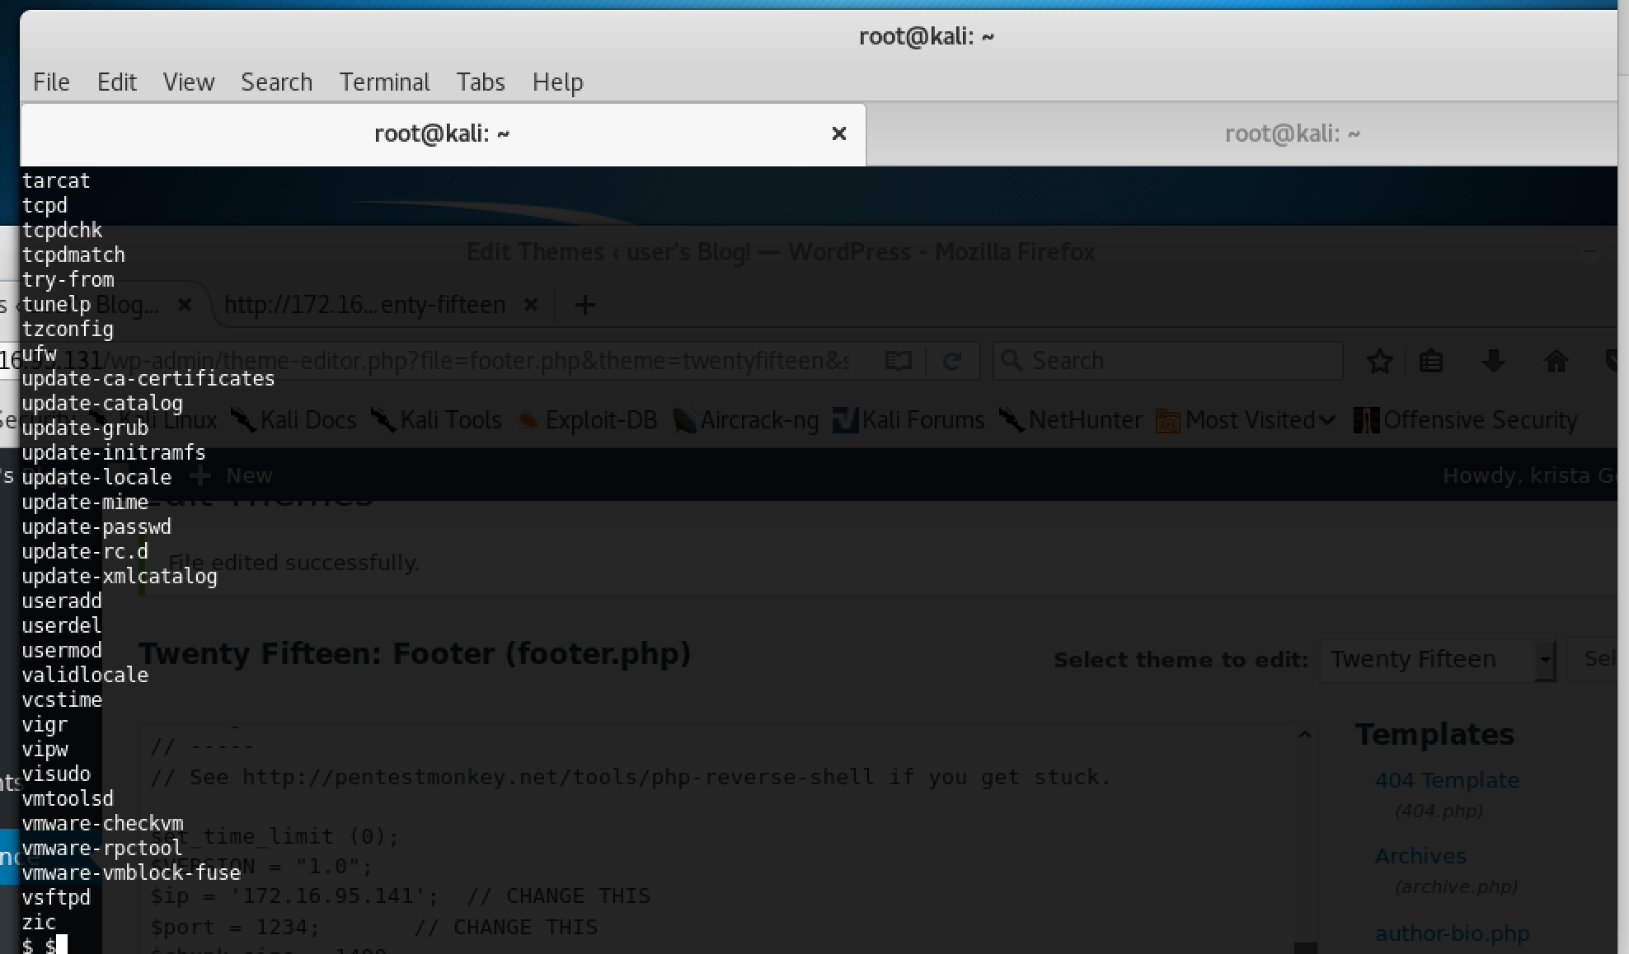
The shellz
After getting lol’d at for taking way too long on this..3 days I think (never take this long)!!
Looking to elevate my privileges!

Slide 24
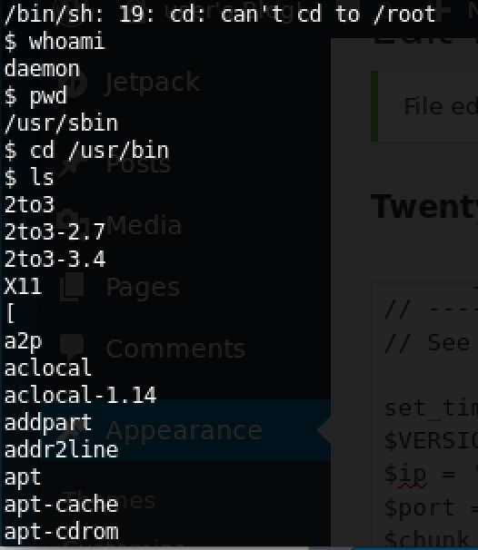
Whoami,pwd,cd /usr/sbin
Whoami- Print the user name associated with the current effective user ID
Pwd- thought its password? But nah
Prints the name of the current working directory.
Maybe there is root directory…cant find it?
Daemon to root? Google it right?
Check if theres a root folder/directory? Don’t think so? Try /home?

Slide 25
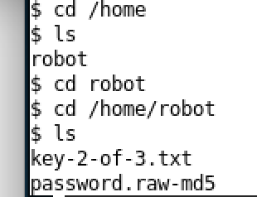
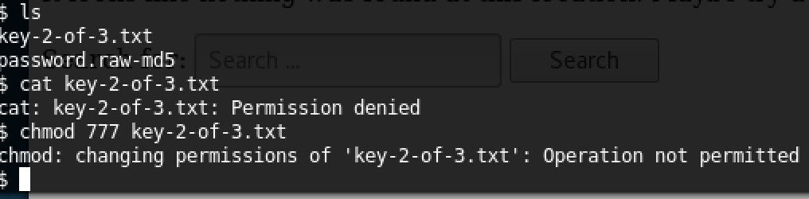
Flag 2-of-3.txt
When the shell popped up I was looking at the folder - ( /usr/sbin )< (whats the correct formatting for this?)
So navigate to /home – cd /home
Theres a folder called ’robot’ in the home directory
Inside that there is the key-2-of-3
Cant cat or change permissions to open it?

Slide 26
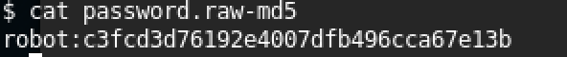
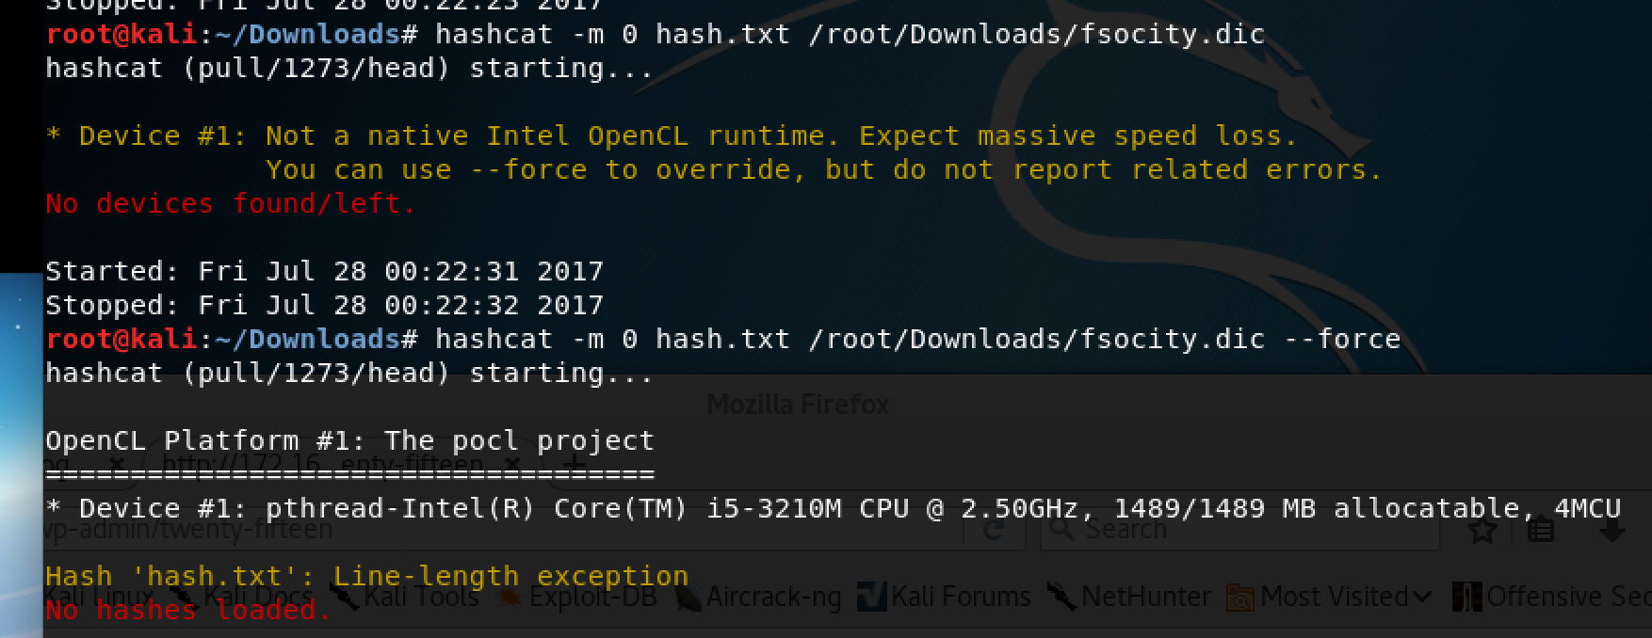
Check out the md5 file?
So that’s the what the passw ord.raw-md5 file contains
robot:c3fcd3d76192e4007dfb496cca67e13b
Need to decrypt this?
Put the above md5 in a txt files
tried using hashcat in conjunction with the c-source file to crack the hash – getting errors?

Slide 27
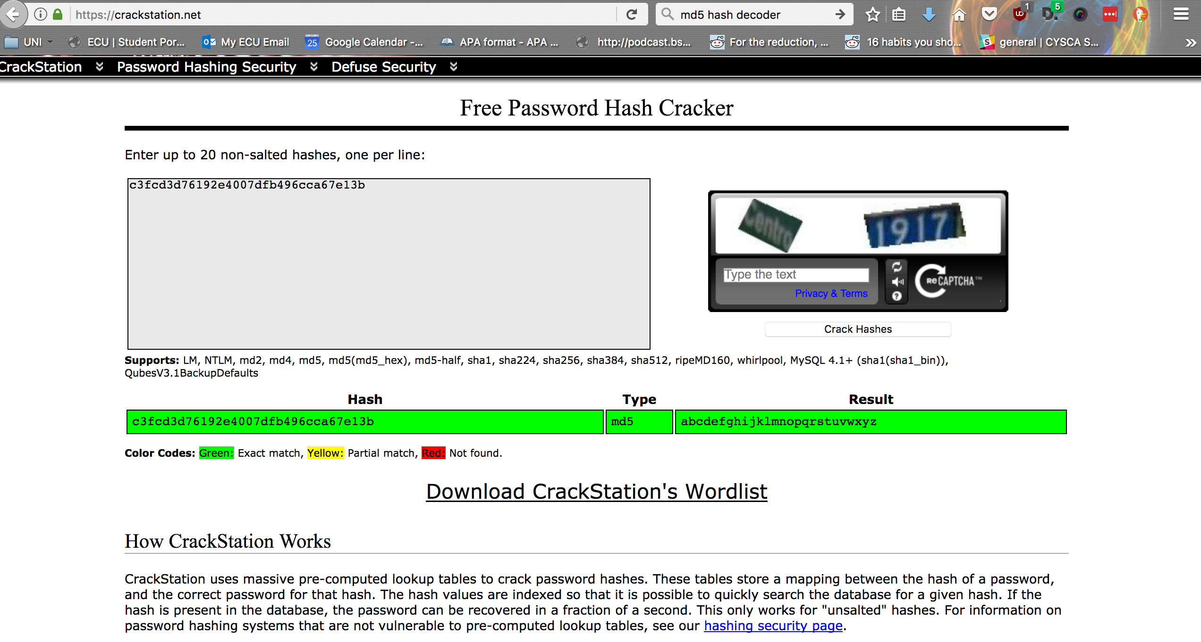
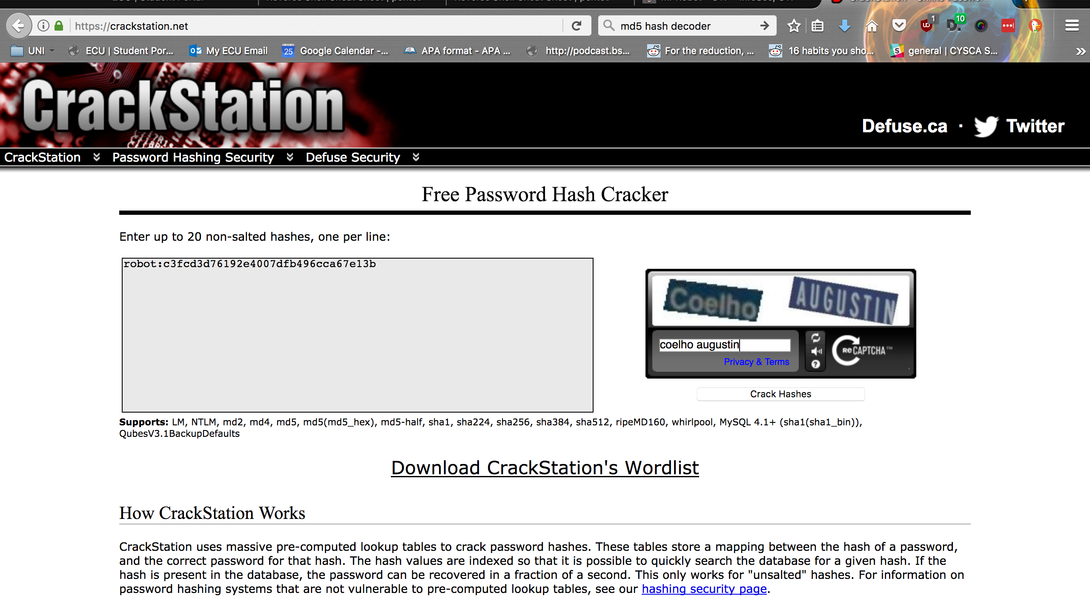
Crackstation?
Rainbow table

Slide 28
So that was handy!
So I guess that translates to :
robot:abcdefghijklmnopqrstuvwxyz
Try this as the login to the VM?
Hash | Type | Result
c3fcd3d76192e4007dfb496cca67e13b | md5 | abcdefghijklmnopqrstuvwxyz

Slide 29
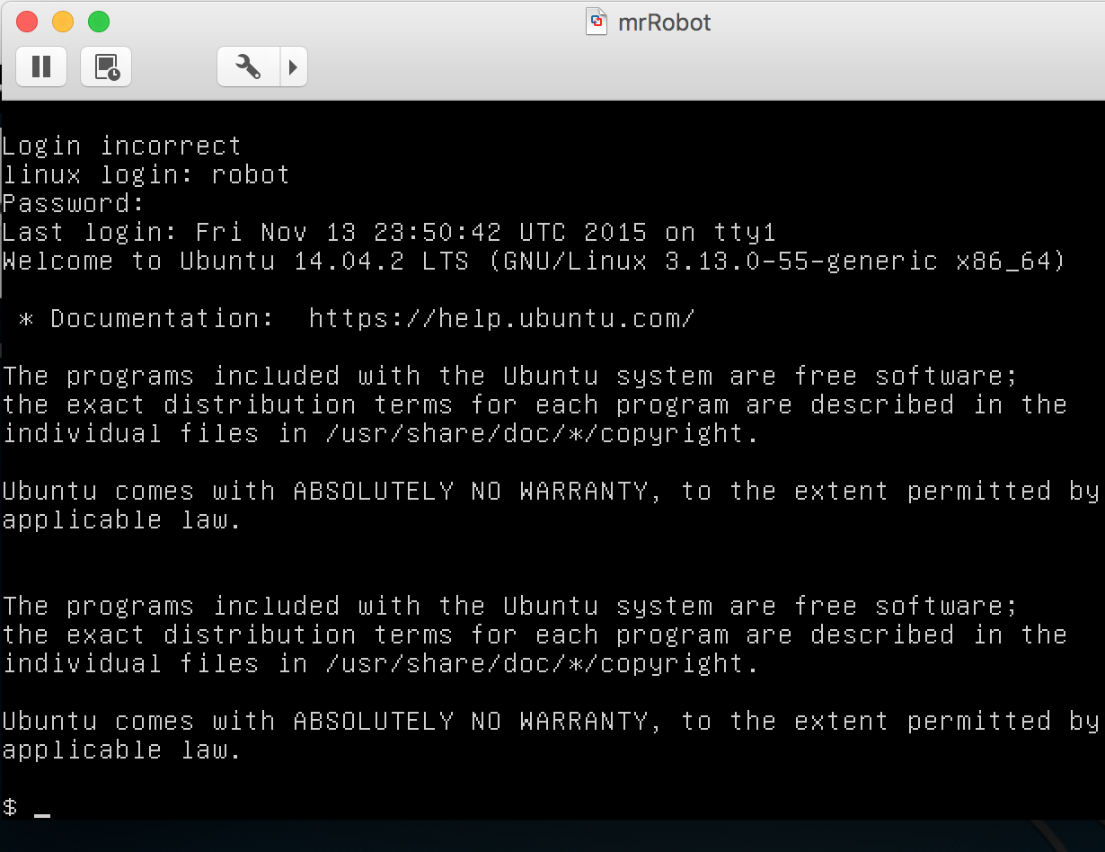
Boom got a shell right?
Got a shell in the VM
Have a gander?
Straight up ’ls’ pimps!

Slide 30
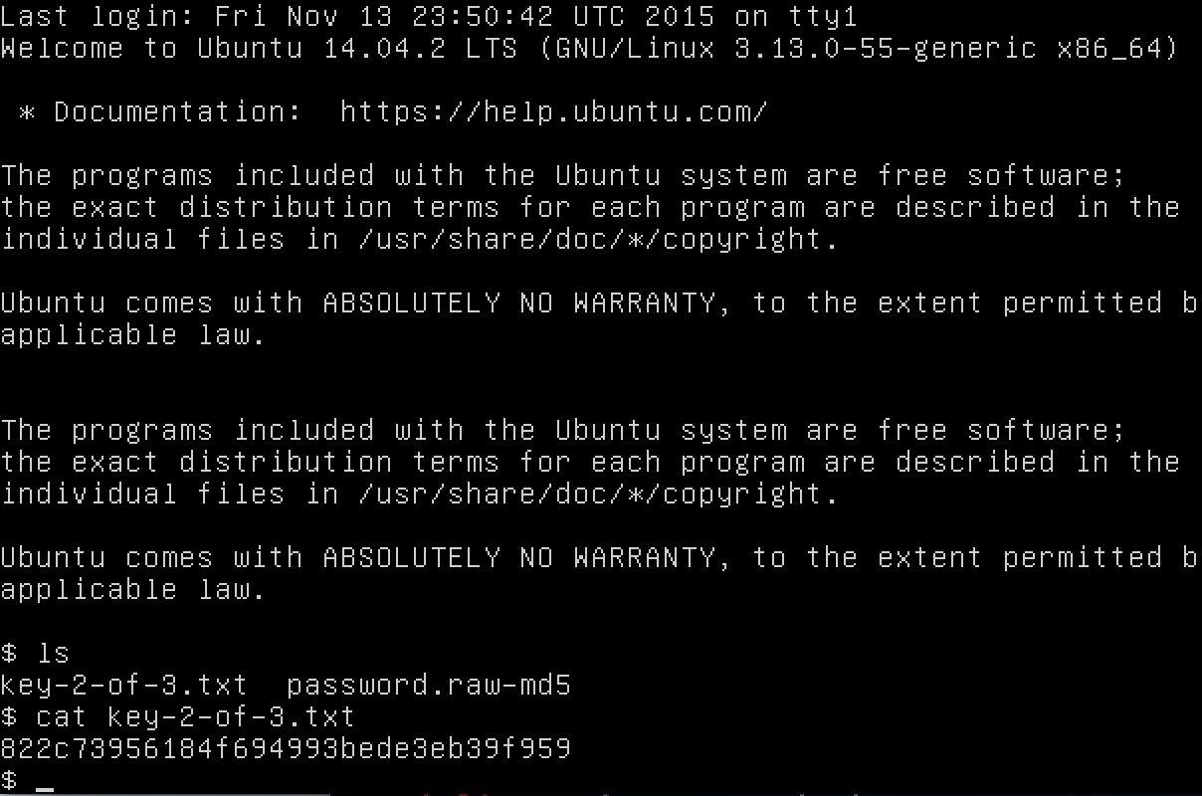
So that’s how I got flag numero 2(key-2-of-3.txt)
So moving on .. Pwd etc
Home/robot

Slide 31
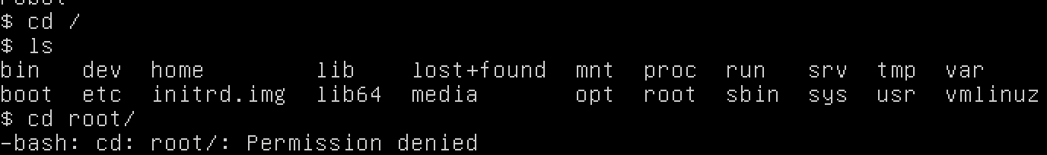
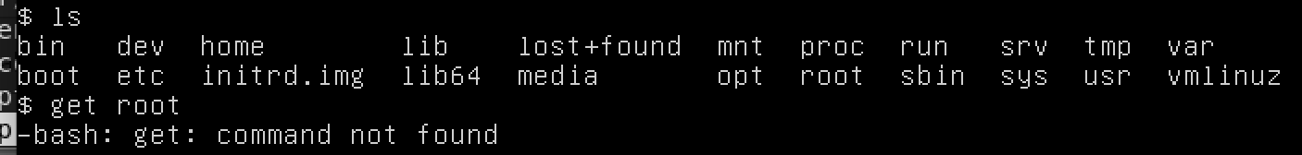
Getting root
So I couldn’t get into the root directory straight away and im logged in as robot..
aha! I have to do something!
This is not how you get root

Slide 32
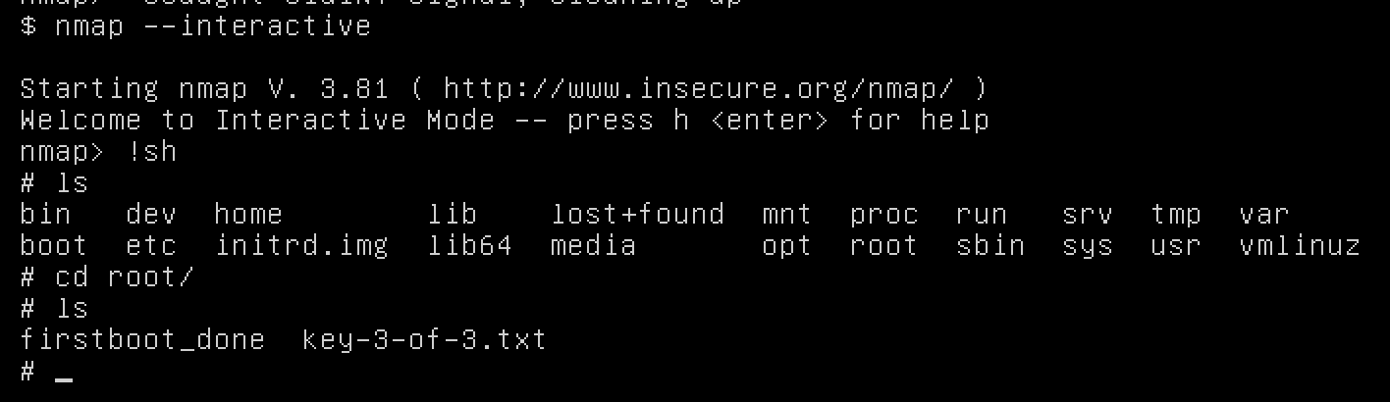

So I don’t really know(maybe?)
Walkthrough?
Which – a command to locate a command
Which nmap?
so nmap on this vm has an interactive mode.
!sh – popped up a shell!
So now I can go in the root directory!
Yada yada lets see whats in it! Key-3-of-3.txt!
All I got to do is cat the .txt file now right?

Slide 33
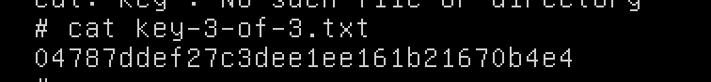
Rightt!
So that’s a wrap I think?
What I learn?
Netdiscover – to find ip address in your network
Nikto – scans a web server for vulns
Nc – so you can listen to a specific port
Pwd – helps you get your bearings
Can manipulate .php/wordpress hosts to send you a shell
Md5 rainbow tables work
I kinda know what getting root is now?

